Slide 1
Set
Java HashSet
Map
Java HashMap

Slide 2
Java Set Interface
The Set interface of the Java Collections framework provides the features of the mathematical set in Java. It extends the Collection interface.
Unlike the List interface, sets cannot contain duplicate elements.

Slide 3
Classes that implement Set
Since Set is an interface, we cannot create objects from it.
In order to use functionalities of the Set interface, we can use these classes:
HashSet
LinkedHashSet
EnumSet
TreeSet

Slide 4
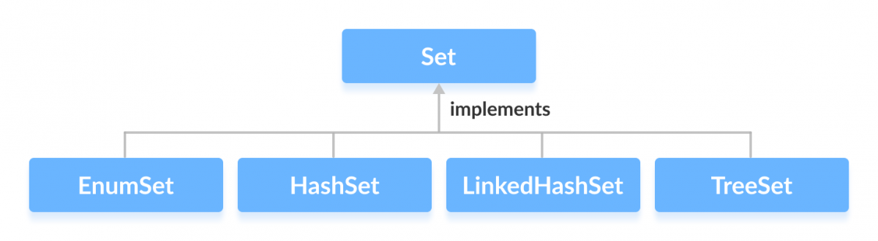
These classes are defined in the Collections framework and implement the Set interface.

Slide 5
Interfaces that extend Set
The Set interface is also extended by these subinterfaces:
SortedSet
NavigableSet

Slide 6
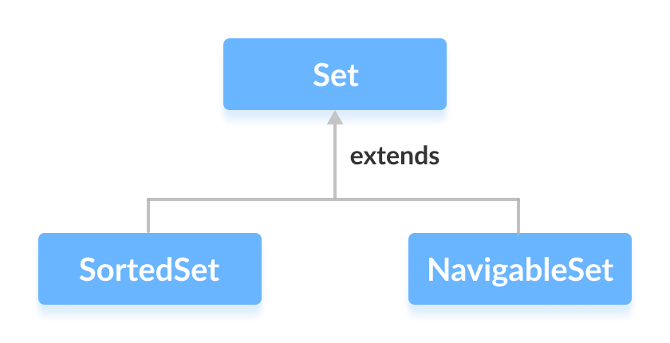

Slide 7
Methods of Set

Slide 8
Implementation of the Set Interface

Slide 9
Java Map Interface
A map contains values on the basis of key, i.e. key and value pair.
Each key and value pair is known as an entry.
A Map contains unique keys.
A Map is useful if you have to search, update or delete elements on the basis of a key.

Slide 10
Java Map Hierarchy
There are two interfaces for implementing Map in java:
Map and SortedMap,
and three classes: HashMap, LinkedHashMap, and TreeMap.
The hierarchy of Java Map is given below:

Slide 12
Hashmap in Java

